Slide 1
Technology, Trade and Occupational Employment
A Cross-Country Analysis of Technology and Trade’s Impact on Occupational Employment and Inequality
Mehmetcan Caniklioglu

Slide 2
Outline
Introduction
Research Question
Literature Survey
Research Strategy
Preliminary Table of Contents
References

Slide 3
Introduction
What are the recent trends in labor markets?
Job polarization
Declining real wages of low skilled jobs
How technology affects labor earning?
Skill-Biased Technical Change (SBTC)
How trade affects labor earnings?
Offshoring (Trade in Tasks)

Slide 4
Research Question (Preliminary)
How did the recent developments in technology and offshoring activity in European Union affected demand for different skills and earnings of different occupations in late 20th and 21st Century?

Slide 5
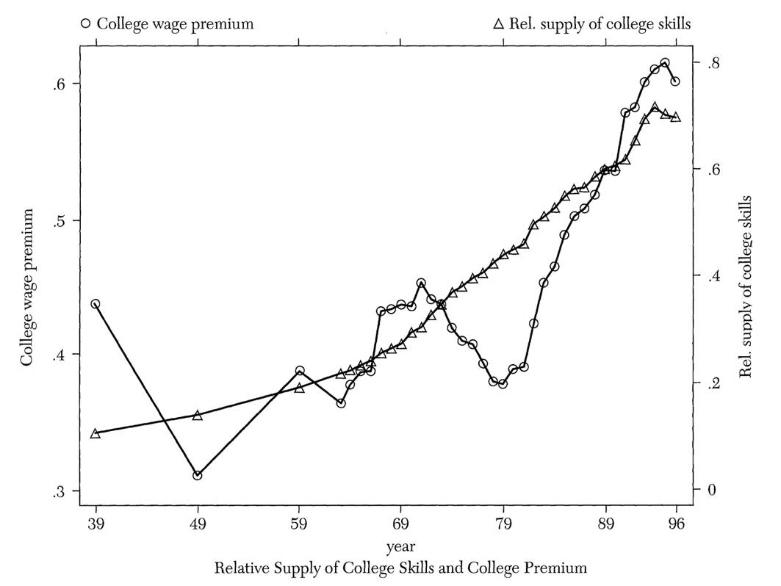
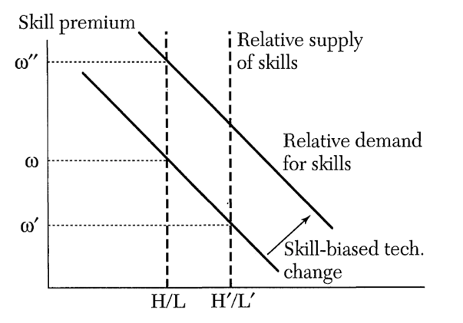
Technology and Heterogenous Labor-SBTC
Figure 1 The Behavior of the (log) College Premium and Relative Supply of College Skills adapted from “Technical change, inequality, and the labor market” by Acemoglu D.
Figure 2 Relative Demand for Skill adapted from “Technical change, inequality, and the labor market” by Acemoglu D.

Slide 6

Skills, Tasks and Occupations
CES Production Function of Katz and Murphy Framework:
$$Y\left(t\right)={[{{(A}_{l}\left(t\right)L(t))}^{ρ}+{{(A}_{h}\left(t\right)H(t))}^{ρ}]}^{1/ρ}$$
$A_{l}(t) and A_{h}(t)$ are factor Augmenting technology terms of low and high skilled labor
Skill is defined as “Worker’s endowment of capabilities for performing various tasks”.

Slide 7
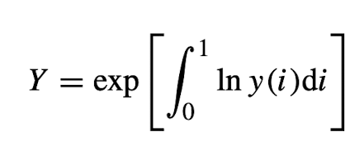
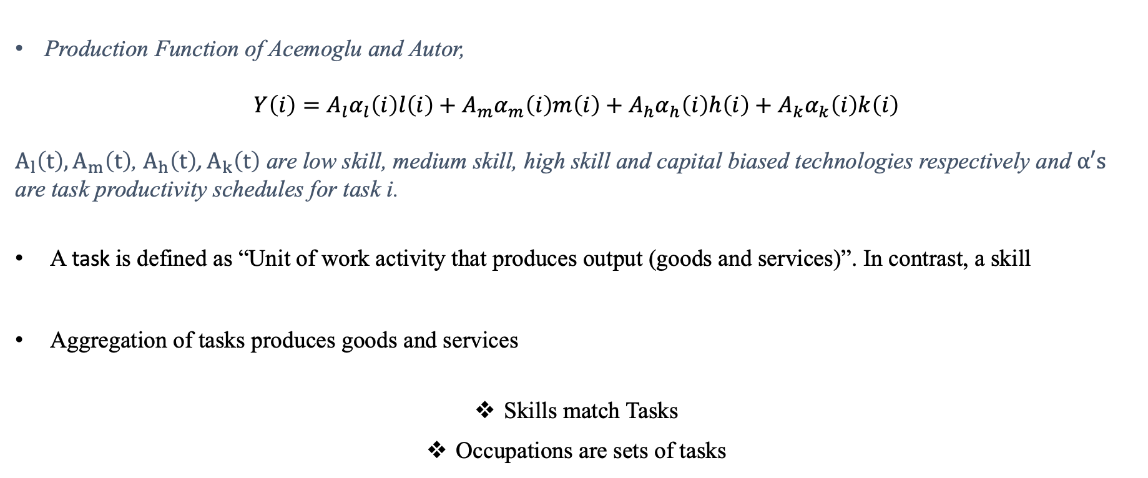
Skills, Tasks and Occupations
Production Function of Acemoglu and Autor,
$$Y\left(i\right)=A_{l}α_{l}\left(i\right)l\left(i\right)+A_{m}α_{m}\left(i\right)m\left(i\right)+A_{h}α_{h}\left(i\right)h\left(i\right)+A_{k}α_{k}\left(i\right)k\left(i\right)$$
$A_{l}\left(t\right),A_{m}\left(t\right)$, $A_{h}\left(t\right)$, $A_{k}\left(t\right)$ are low skill, medium skill, high skill and capital biased technologies respectively and $α′s$ are task productivity schedules for task i.
A task is defined as “Unit of work activity that produces output (goods and services)”. In contrast, a skill
Aggregation of tasks produces goods and services
Skills match Tasks
Occupations are sets of tasks

Slide 8
Trade in Tasks: Offshoring
What makes a task (or a job) offshorable?
Autor, Levy, and Murnane (2003)
face-to-face and on-site interactions
routine vs. non-routine
cognitive vs. non-cognitive aspects of occupations.
What can measure offshoring?
Foreign direct investment outlows?

Slide 9
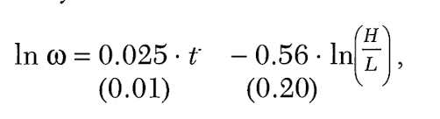
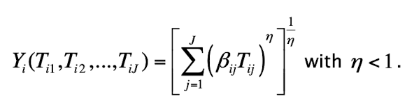

Research Strategy
Katz and Murphy
$$Y\left(t\right)={[{{(A}_{l}\left(t\right)L(t))}^{ρ}+{{(A}_{h}\left(t\right)H(t))}^{ρ}]}^{1/ρ}$$
Goos, Manning and Salomons
OLS
Analysis of Variance
ANOVA

Slide 10

Research Strategy
Acemoglu and Autor
$$Y\left(i\right)=A_{l}α_{l}\left(i\right)l\left(i\right)+A_{m}α_{m}\left(i\right)m\left(i\right)+A_{h}α_{h}\left(i\right)h\left(i\right)+A_{k}α_{k}\left(i\right)k\left(i\right)$$
Occupational basis
Control variables
?

Slide 11
Research Strategy
Data Sources:
European Union Labor Force survey (ELFS) | Occupation level labor supplies
OECD STAN | Industry level outputs
The World Bank Group | Foreign Direct investment
Penn Table | Macroeconomic (Control) variables
UN Comtrade Database | Trade quantities
European Community Household Panel (ECHP) | Occupation level labor earning
European Union Statistics on Income and Living Conditions (EU-SILC) | Occupation level labor earning

Slide 12
Preliminary Table of Contents
Introduction
View From the Shoulders of Giants: Survey of Current Literature
Data Sources
Recent Trends in the European Union Labor Markets
Theoretical Framework
Results of Empirical Analysis
Conclusion

Slide 13

References
Acemoglu, D. (2002). Technical change, inequality, and the labor market. Journal of Economic Literature, 40(1), 7-72.
Acemoglu, D., & Autor, D. (2011). Skills, Tasks and Technologies: Implications for Employment and Earnings. Handbook of Labor Economics, 4, 1043-1171.
Goos, M., Manning, A., & Salomons, A. (2010). Explaining job polarization in Europe: The roles of technology, globalization, and institutions. CEP Discussion Paper No 1026.
Katz, L. F., & Murphy, K. M. (1992). Changes in the relative wages, 1963-1987: Supply and demand factors. The Quarterly Journal of Economics, 107(1), 35-78.

Slide 14
Thank you for your attention
Any Questions?

